Slide 1
Fitspace Status
by Adril Kemyem
Marilena Soussani
Mike Jun Yang Chiu Lim

Slide 2
Why Is Fit Space Status Important? '
Save time by knowing beforehand if the gym is crowded or not
See which equipment are currently occupied
Engage in workout class or hire a personal trainer
Receive a healthy diet meal from a nutritionist
Access your membership card virtually
Reserve gym, room, pool, and equipment

Slide 3
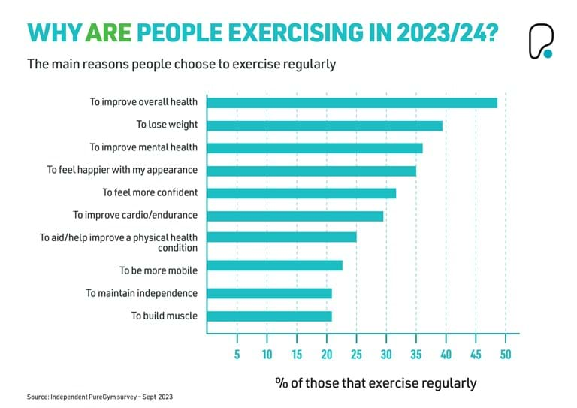

Slide 4
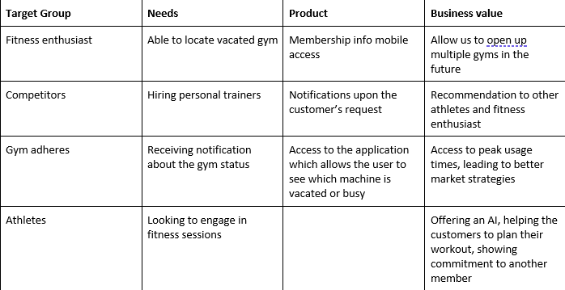
Product Vision

Slide 5
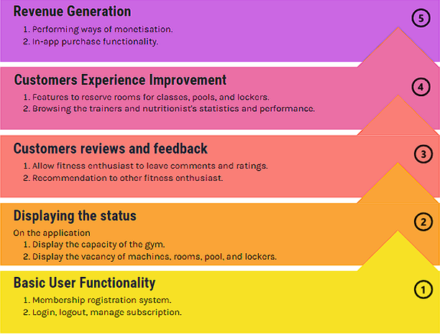
Roadmap

Slide 6
Product Scope
User Registration: Allow the user to open an account online and log into the application.
Vacancy: Provide the user the information of occupied equipment in every section of the gym.
Virtual Card: Allow the user to show his/her membership card in case forgotten the physical one at home
Profile Management: Allow the user to modify notifications, payments and reservation.
Engage in classes: The user can review different trainers and hire a personal one or schedule a date and time in a group workout.
Trainers: Review the performance and biography of the trainers.
Nutritionists: View the recommended diet meal provided, and have a peek at the receipt for people with different metabolism.
Reviews and ratings: Enable fitness enthusiast to leave a comment about their experience.

Slide 7
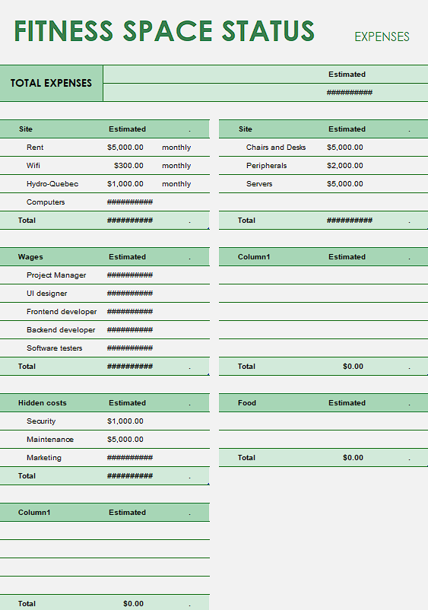
Budget

Slide 8
Mockup

Slide 9
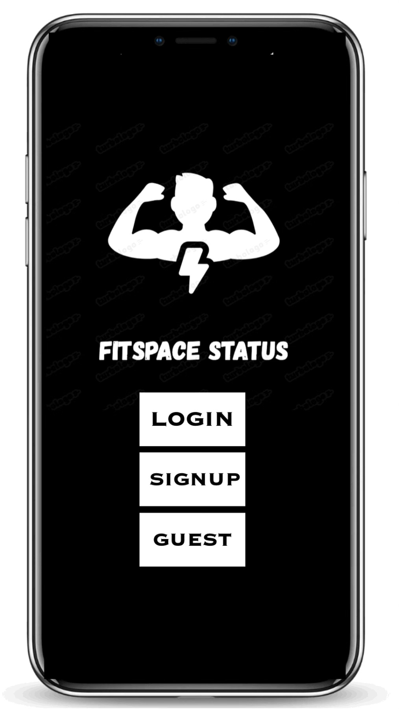
Login Page
Login
Enter your username
Enter your password
Biometric verification
Sign Up
Name
Email
Age
Subscription
Guest
One time use 24-hours with email

Slide 10
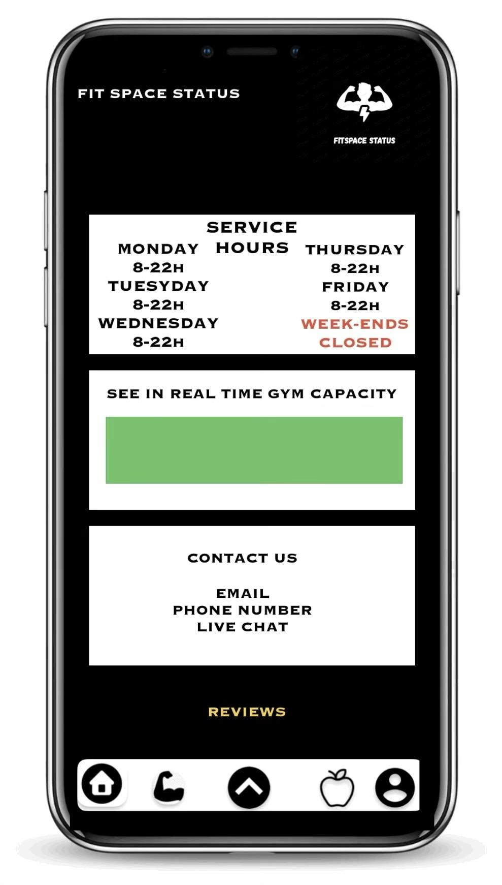
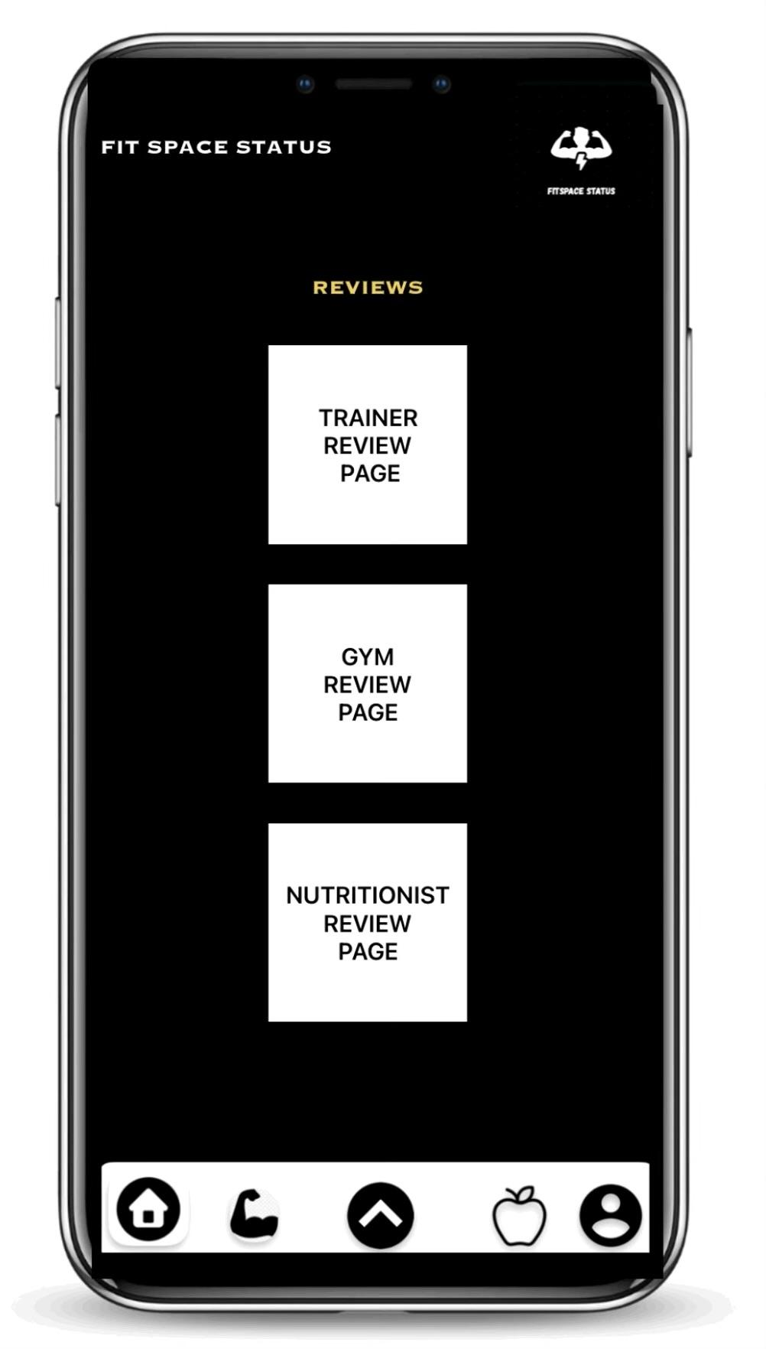
Home Page
Display the opening hours
Display the vacancy of gym
Contact info
Reviews
View the trainer’s feedback
View the gym’s reviews
View the nutritionist’s ratings

Slide 11
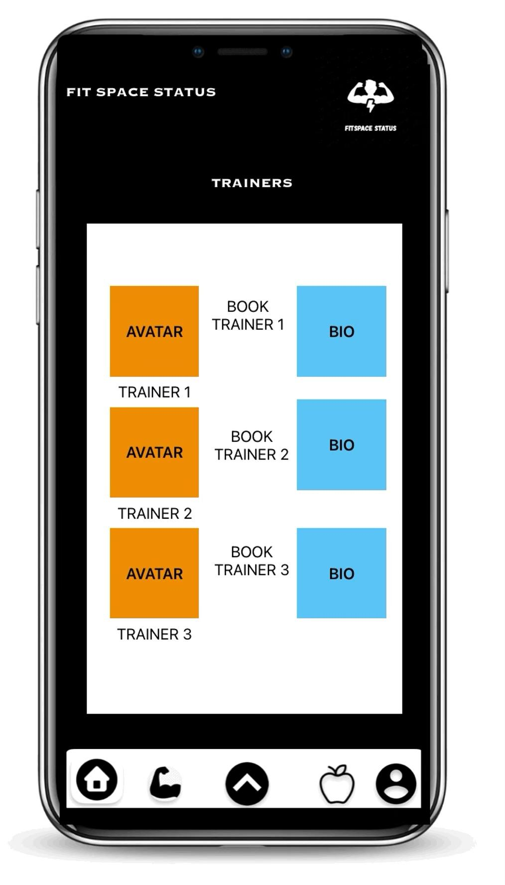
Trainers Page
Book trainer
Schedule the date and time
Biography
View the trainer’s biography
Email
Performance

Slide 12
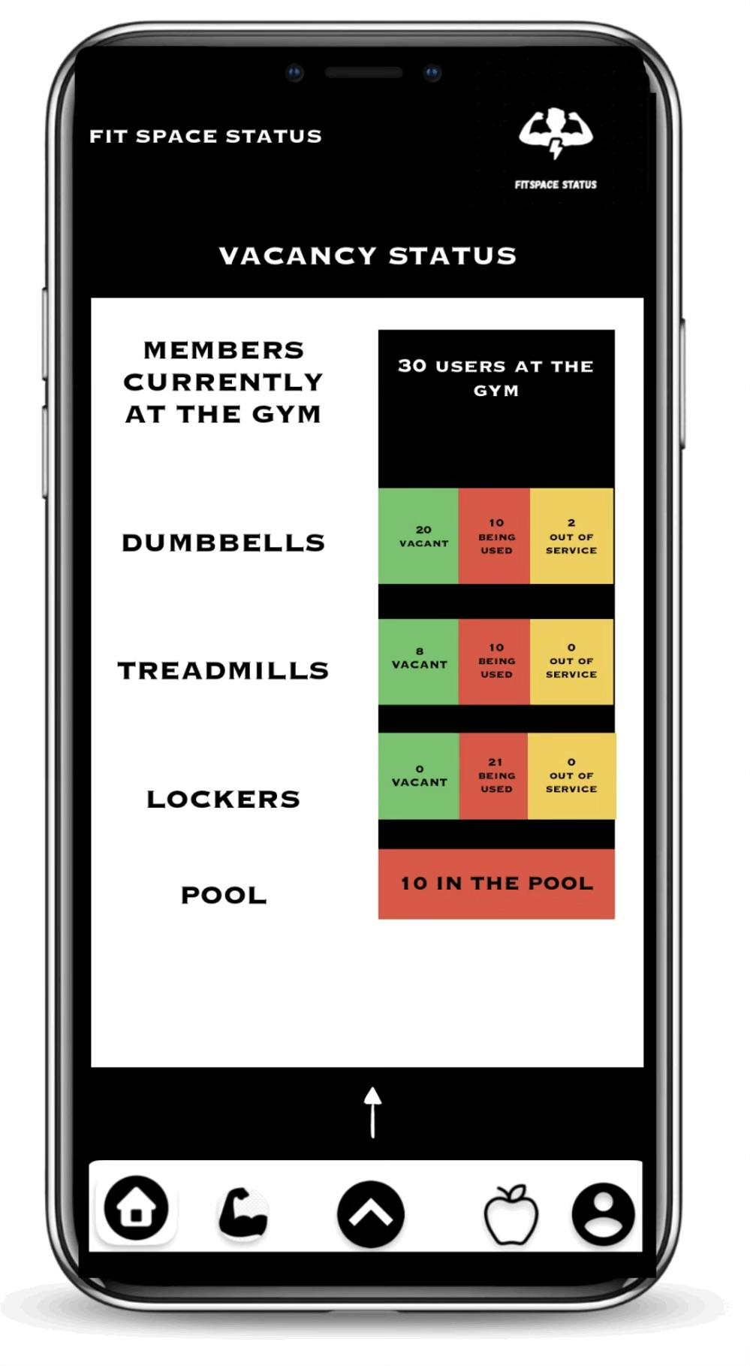
Vacancy Status Page
Display the no. of fitness enthusiast entered the gym
Display the no. of machine from each section being vacant, occupied, and under maintenance
Display the no. of empty lockers
Display the no. of people entered the pool

Slide 13
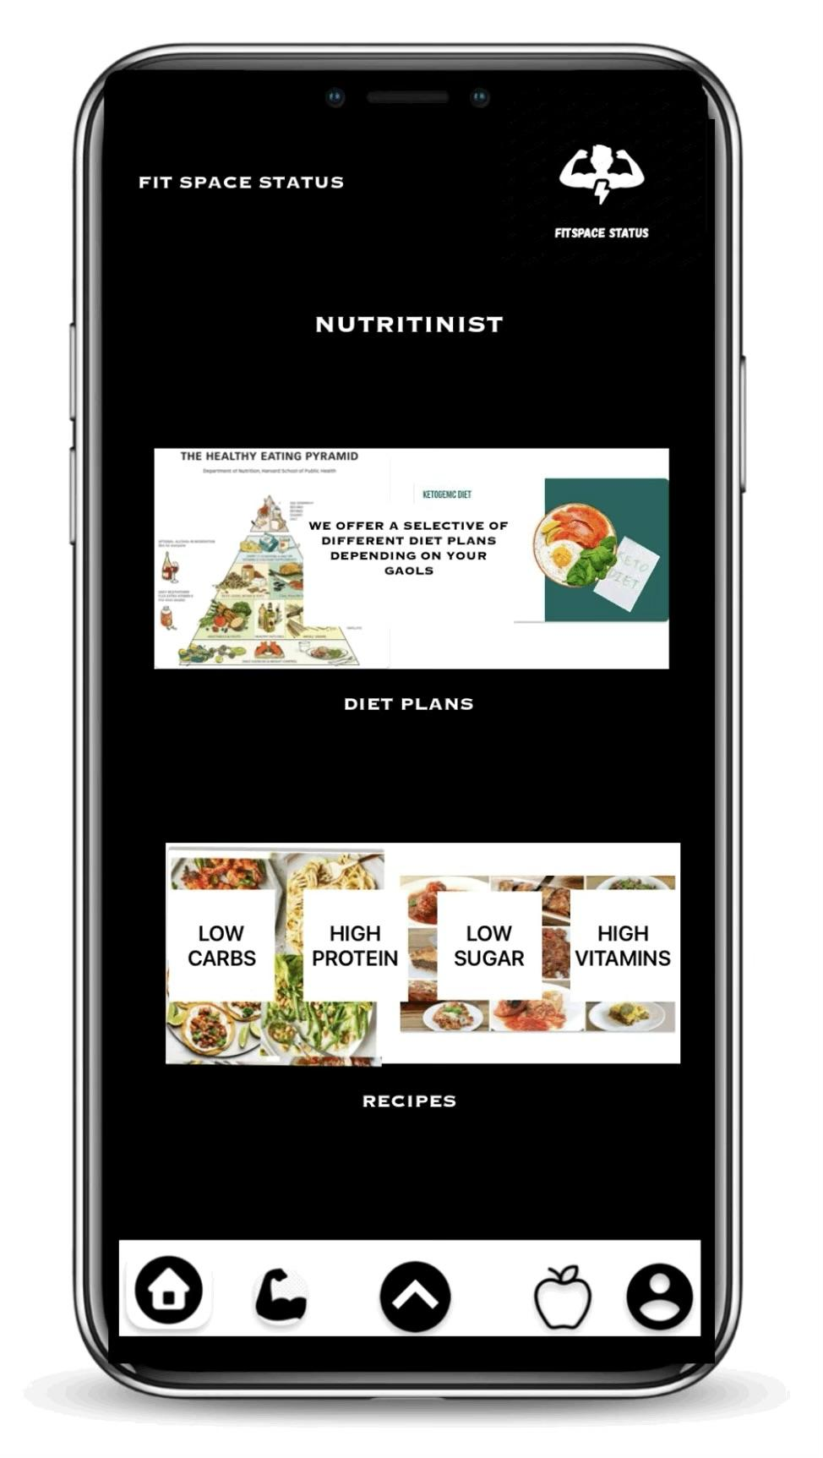
Nutritionist Page
Diet Plans
View the meals recommended by the nutritionist
Recipes
View the recipes of foods and drinks
from different category

Slide 14
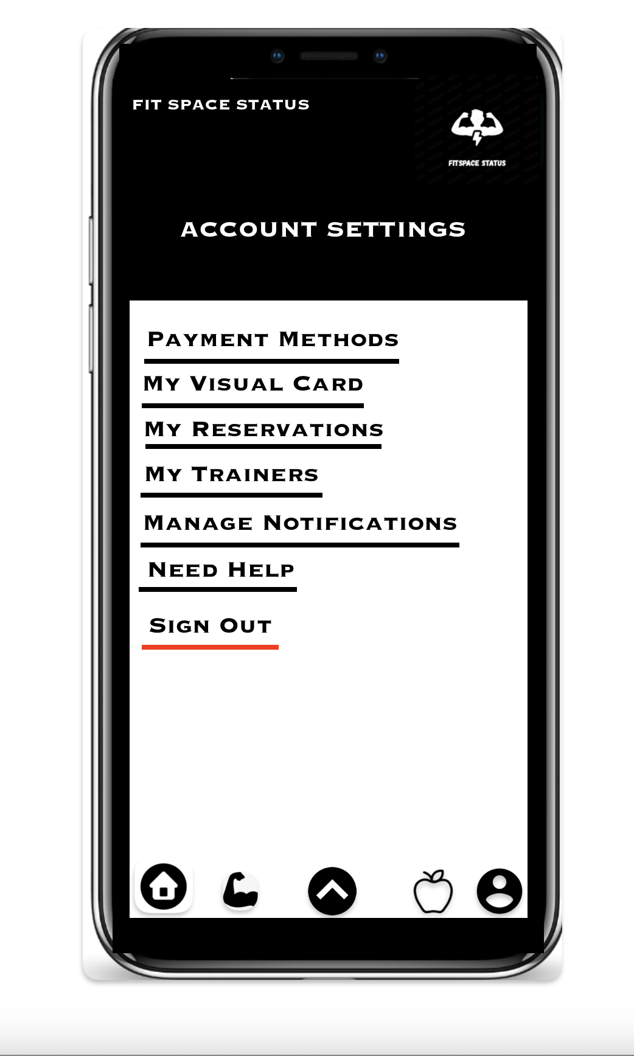
Account Page
Payment Method
Manage subscription
Visual membership card
Access the gym with your phone
Reservation
View your reserved room, class, pool, equipment, and the gym (for fundraisers)
My trainers
View trainer
Schedule date and time
Cancel
Manage notifications
On/off machine vacancy
On/off gym status
On/off upcoming payment
Need help
Call an assistant
Sign out
Logout the account
Picture here

Slide 15
Retrospective
WHAT WENT WELL : Teamwork, manage to complete our tasks that were assigned
WHAT COULD’VE BEEN IMPROVED: Communications and deeper understanding between us, time management
OVERALL SATISFACTION ABOUT THE FINAL PRODUCT: The application looks buzzing, everything function well, and we are ecstatic of what we built.

